Slide 1
Cyanotic
Congenital Heart Disease
Diagnostic Approach -
Dr. D. Muthukumar MD, DM
Prof. of Cardiology
Sri Muthukumaran Medical College
Hospital and Research Institute, Chennai-69

Slide 2
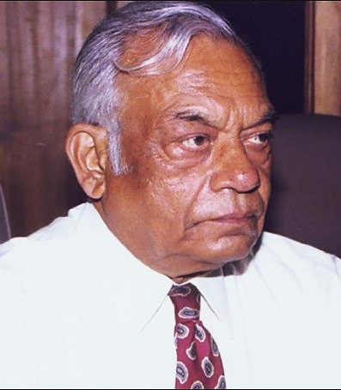
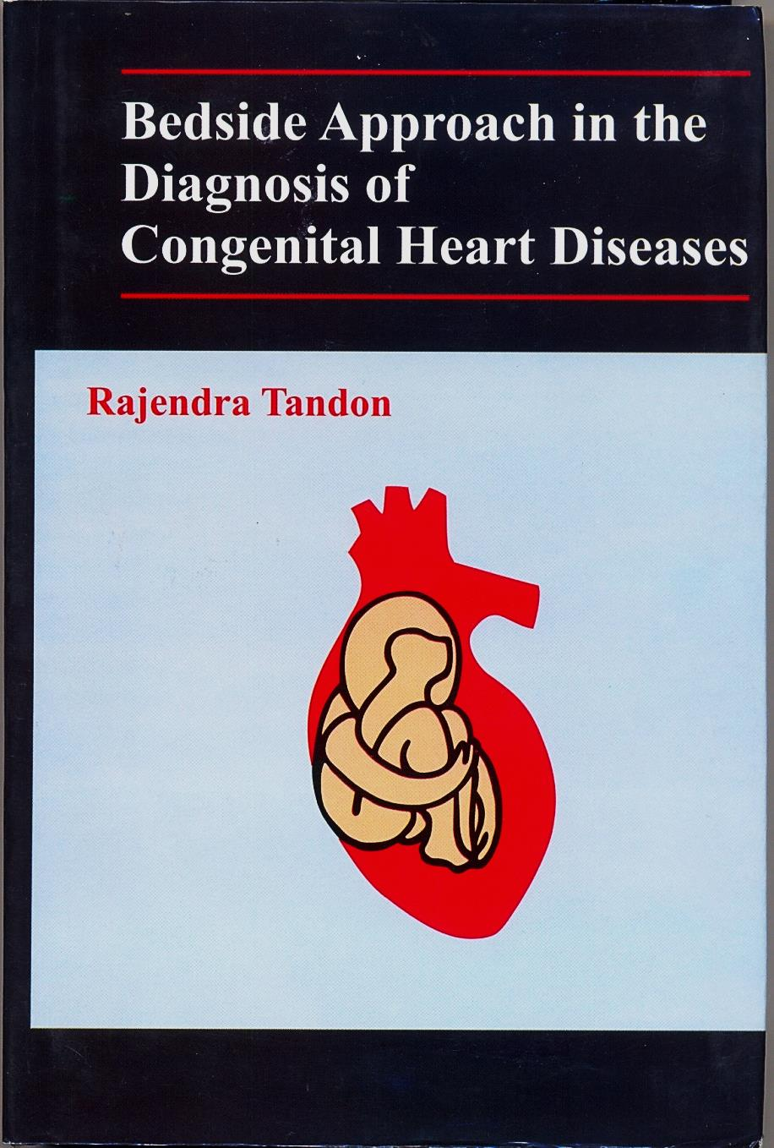

Slide 3
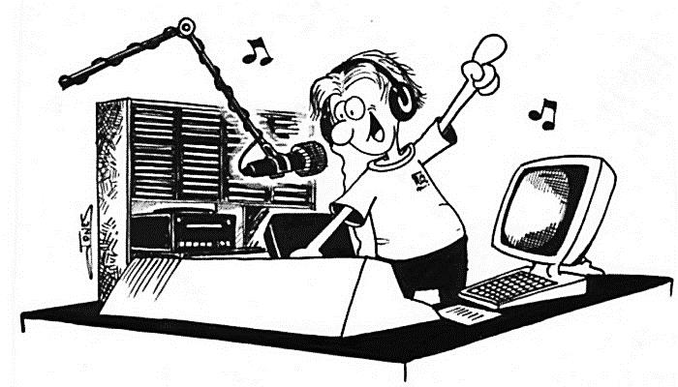
 Late Prof. Rajendra Tandon
 Dr. S. Radhakrishnan

Slide 4
Congenital Heart Disease
Acyanotic
Stenotic
Shunt lesions
(mostly)
Outflow &
Arterial
obstructions
Cyanotic
Congenital
Heart Disease

Slide 5
Cyanotic Congenital Heart Disease
- Cardinal Clinical features -
• Cyanosis
• Clubbing
• Polycythemia

Slide 6
CLINICAL
SYMPTOMS

Slide 7
1. ONSET OF CYANOSIS
Newborn period
1st week
• Pul. Atresia
• Tricuspid atresia
• TGA
• TGA
• Tricuspid atresia
• TAPVC
• Truncus Arteriosus
After 1 month
• TOF (severe type)
• Pulmonary Atresia
with Hypoplastic RV
• Hypoplastic RV
• TOF
• TGA
• TAPVC

Slide 8
Cyanotic CHD In Adults
Cyanotic HD with  PBF
• TOF / Pulmonary atresia
• Non-TOF conditions with PS :
Tricuspid atresia, TGA, DORV, Single ventricle
• Ebstein's anomaly
Eisenmenger syndrome
• Large VSD, PDA, ASD with increased PBF
Cyanotic HD with  PBF
• Unobstructed TAPVC
Cyanotic HD with Normal PBF
• Pulmonary A-V fistula
• Left SVC to LA

Slide 9
2. SEVERITY OF CYANOSIS
• Neonate suspected of having a CHD in Shock /
Profound cyanosis / Acidosis :
Ductus-dependent CHD such as
- Pulmonary atresia
- Aortic atresia
- Hypoplastic Left Heart Syndrome (HLHS)
- Interrupted Aortic Arch etc.
• More severe cyanosis :
Associated with Complex Cyanotic Cong. HD
• Cyanosis with  PBF :
Well tolerated, unless presenting with cyanotic spell

Slide 10
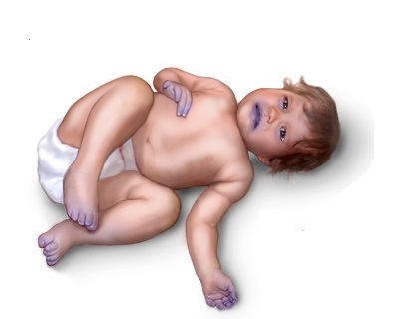
3. PATTERN OF CYANOSIS
Cyanosis : Intermittent
Ebstein’s Anomaly
Cyanosis : Uniform
Rt. → Lt. Shunt
at Atrial,
Ventricular or
Ascending Aorta level

Slide 11
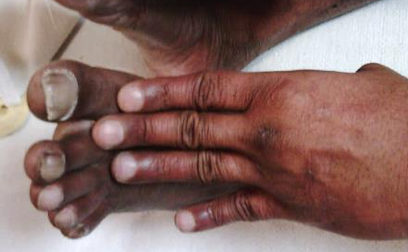
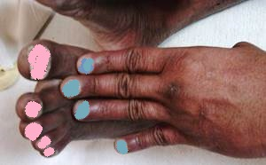
Cyanosis : Differential
Normally related GV +
Severe PAH + Rt. → Lt. Shunt thro PDA
Normally connected GV
Severe PHT
Rt to Lt shunt thro PDA
FINGERS : RED
TOES : BLUE
Cyanosis : Reversed Differential
D-TGA +
Severe PAH + Rt. → Lt. Shunt thro PDA
D-Transposition of GV
Severe PHT
Rt to Lt shunt thro PDA
FINGERS : BLUE
TOES : RED

Slide 12
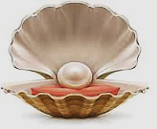
❖ Hyperoxia test :
Rt radial ABG in air and after 10 min of 100% O2
- paO2 > 300 mmHg : Excludes Cyanotic CHD
- paO2 > 200 mmHg : Unlikely to be Cyanotic CHD
(NB : False Negative in TAPVC-Unobstructed)
- paO2 < 100 mmHg
(usually lower)
: Likely to be Cyanotic CHD
( DD : Severe Lung disease (high paCo2) , PPHN )
So .... Cyanosed or Not ?
Pearl

Slide 13
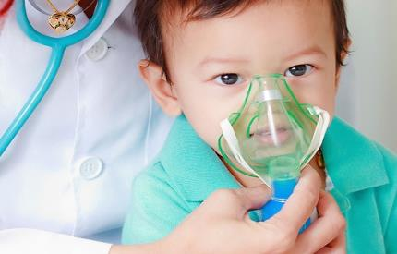
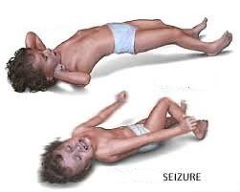
Other Symptoms :
Difficult
feeding
Difficult
breathing
Syncope
Poor growth
Poor weight gain
Frequent
respiratory
infections
Seizure

Slide 14
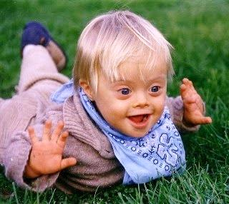
Chest Pain
Stridor
Palpitations
Syndromic
appearance

Slide 15
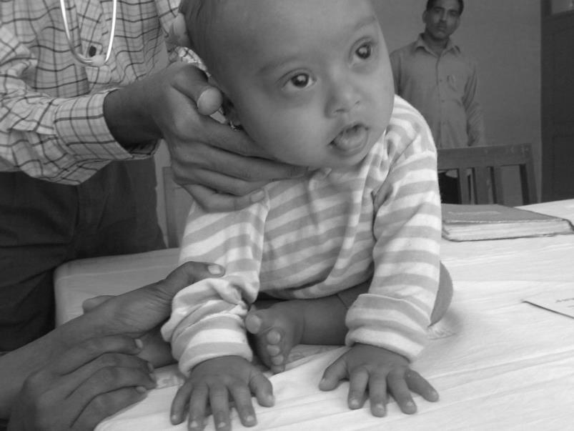
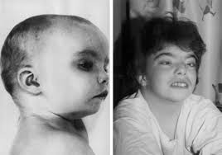
Sometimes one can
Look & Tell...
Down syndrome
(Trisomy 21 syndrome)
AVSD + PS
TOF
DiGeorge syndrome
(22q11.2 deletion syndrome)
Truncus Arteriosus
TOF / DORV

Slide 16
CLINICAL
SIGNS

Slide 17
Cyanotic Cong. HD
Physical Examination
• Appearance : Pale, Dusky, Polycythemic, Syndromic
• Presence of Cyanosis, Clubbing
• Tachypnea, Respiratory distress
• Weight, Height for physical development
• Skeletal abnormalities: Polydactyly, others
• Pulse : Tachycardia, Arrhythmia, Volume, Palpability
• BP : All 4 limb BP in complex CHD
• JVP : - Elevated in Tricuspid Atresia, Eisenmenger physiology
- Normal in TOF
• Abd: - Sidedness of liver/spleen + palpation of Apical Impulse
to rule out Dextrocardia
- Hepatomegaly

Slide 18
Cyanotic Cong. HD
• Precordial examination
• Auscultation
Heart sounds & Murmurs

Slide 20
Cyanotic
Congenital Heart Disease
Purpose of Clinical Recognition
1. Not to diagnose lesion ‘exactly’
2. Try to diagnose the ‘physiological’ basis
Decide whether  or  PBF or PHT
3. Narrow differential diagnosis to a group
Using History, Examn, CXR and ECG, form a working
impression of the disease, based on prevalence
4. Recognize features unusual to a group
❖ Daily surprises galore
❖ Do not be disappointed

Slide 21
Cyanotic Congenital Heart Disease
↓ PBF
↑ PBF
N-PBF
Abnormal
Mixing
Combination

Slide 22
CLINICAL DIFFERENCES BETWEEN CYANOTIC HD WITH  AND  PBF
 | DECREASED PBF (eg. TOF) | INCREASED PBF (eg. TGA, TAPVC)
Presentation at | Any age | Neonate / Infant
Appearance | Comfortable | Sick, Lethargic, Irritable
Cyanosis | Mild - Severe | Mild (except TGA with intact IVS)
Squatting /Cyanotic spells | Common | Uncommon
Feeding difficulty / Sweating | Absent | Present
Failure to thrive | Absent | Present
Weight Gain | Normal | Suboptimal
Recurrent LRI | No | Yes
Tachypnea | Absent | Present
Heart size | Normal | Cardiomegaly
CHF, Tachycardia, S3, S4 | Absent | Present
Thrill | Maybe Present | Absent
Murmur | Systolic | Soft, Diastolic
CXR | Ischemic Lungs, No Cardiomegaly | Plethoric Lungs, Cardiomegaly

Slide 23
1
↓ PBF

Slide 24
Cyanotic Congenital Heart Disease
↓ PBF
PS / Pul.Atresia
No PS
PAH
Large VSD
No VSD
Eisenmenger
physiology
No VSD
Cyanotic CHD
Cyanotic CHD
Hypolastic RV + ASD
(Rt. to Lt. Shunt thro IAS)
PBF
PS
VSD
PBF
PS
IVS
Fallot’s physiology
PS + ASD
(Rt. to Lt. Shunt thro IAS)
TOF
TGA-VSD-PS
DORV-VSD-Severe PS
Non-TOF
Single Ventricle (LV)-PS
Pul. Atresia + VSD

Slide 25
Cyanotic
Congenital Heart Disease
↓ PBF
PS
VSD
Fallot’s
physiology

Slide 26
Fallot’s
physiology
Cyanotic CHD
↓ PBF
PS
VSD
• TOF
• Pul. Atresia/VSD
• DORV/VSD/PS
• DTGA/VSD/Severe PS
• VSD/PS
RV
• Tricuspid Atresia/Restr.VSD/PS
• Single Ventricle (LV)/PS
• Pul. Atresia/Intact IVS/Small RV
• LSVC to LA
LV

Slide 27
Cyanotic CHD
Fallot’s physiology
↓ PBF
PS
VSD
Symptoms
1. Late onset of cyanosis ( > 6 months )
2. Squatting /Cyanotic spells
3. No CHF
4. Cerebral abscess may occur

Slide 28
Cyanotic CHD
Fallot’s physiology
↓ PBF
PS
VSD
Clinical Examination
• JVP : Normal / Prominant 'a'
• Normal heart size
• Quiet precordium / Parasternal impulse : Mild
• Systolic thrill : Uncommon
• S2 : Single (Widely split in Infundibular PS)
• Pul. ESM - Inversely proportional to cyanosis severity
• Diastole : Clear (No S3, S4 or Diastolic murmur)
• CXR : No cardiomegaly, Pul. Oligemia

Slide 29
Clinical features
Exceptions
• Severe polycythemia : No murmurs
• LTGA : Loud palpable S2 in 2LICS
• Intact IVS / No VSD :
- Lt. parasternal heave
- Cardiomegaly

Slide 30
Cyanotic CHD
Fallot’s physiology
↓ PBF
PS
VSD
Chest X-ray
1. No cardiomegaly
2. Absence of MPA / Pulmonary bay +
3. Dark lung fields - ‘Stringy’ vessels
4. Rt. Aortic Arch : TOF / Pul. Atresia + VSD
Lt. sided Aorta : LTGA

Slide 31
Chest X-ray
Exceptions
1) Cardiomegaly occurs if there is no VSD,
Increased collateral flow with presence of MAPCAs
and in TOF Absent PV
2) MPA is prominent in PS with ASD and intact IVS,
Absent PV

Slide 32
Cyanotic CHD
CXR
↓ PBF
PS
VSD
TETRALOGY OF FALLOT
- PBF
- Pul. Oligemia
- No Cardiomegaly
- MPA not prominent
Pul. bay +
- RV Apex
- Enlarged Aorta
- Boot shaped heart
RV

Slide 33
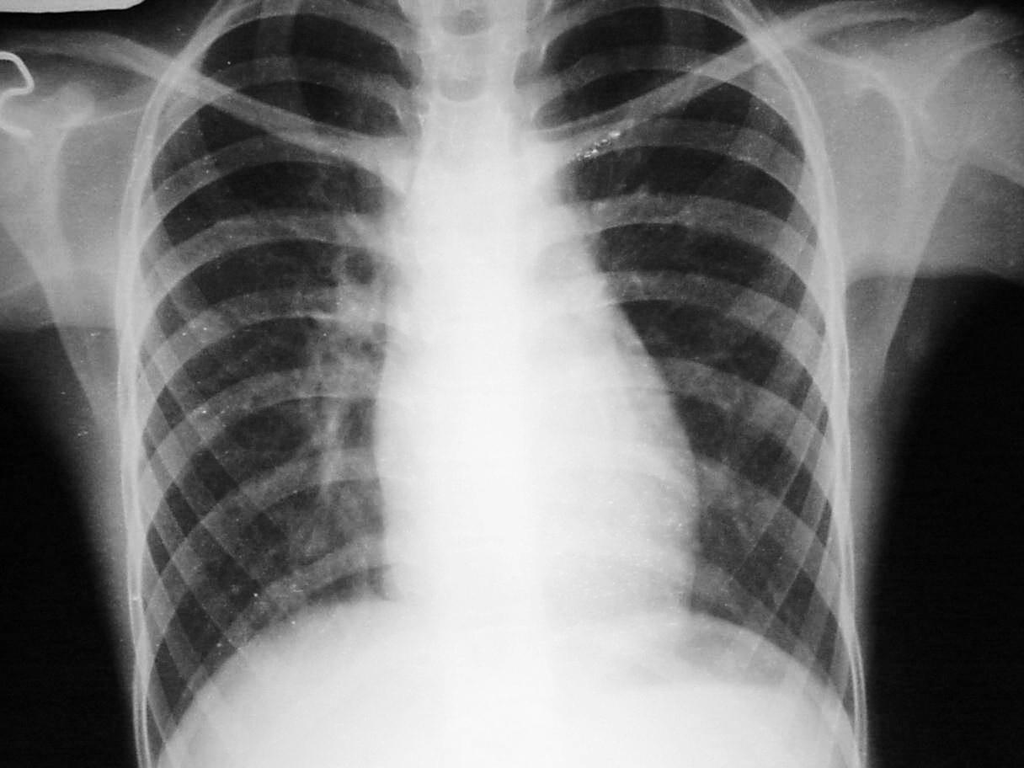
Cyanotic CHD
CXR
↓ PBF
PS
VSD
TRICUSPID ATRESIA
- PBF
- Prominent SVC
- LV type apex
LV

Slide 34
Cyanotic CHD
Fallot’s physiology
↓ PBF
PS
VSD
ECG
QRS AXIS | CHAMBER HYPERTROPHY | CONDITION
RAD | RVH | TOF / DORV / TGA / SV
RAD | LVH | DORV with Restrictive VSD SV / Hypoplastic RV
LAD | LVH | TA / SV / DORV (Rare)
LAD | RVH | AVCD / SV / DORV (Rare) / LTGA
In TOF : RAD not exceeding + 150 / RVH with transition zone in V2
In SV : LAD/RAD Equiphasic complexes or No transition in chest leads without a Q wave

Slide 35
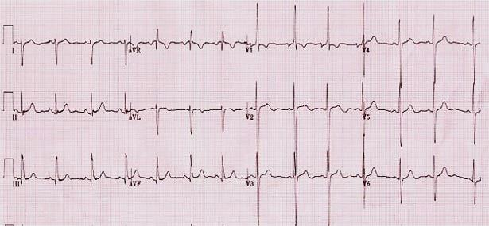
Cyanotic CHD
ECG
↓ PBF
PS
VSD
RAD with RV forces
TOF

Slide 36
Cyanotic
Congenital Heart Disease
↓ PBF
PAH
Eisenmenger
physiology

Slide 37
Cyanotic Congenital Heart Disease
↓ PBF
PS / Pul.Atresia
No PS
PAH
Large VSD
No VSD
Eisenmenger
physiology
No VSD
Cyanotic CHD
Cyanotic CHD
Hypolastic RV + ASD
(Rt. to Lt. Shunt thro IAS)
PBF
PS
VSD
PBF
PS
IVS
Fallot’s physiology
PS + ASD
(Rt. to Lt. Shunt thro IAS)
TOF
TGA-VSD-PS
DORV-VSD-Severe PS
Non-TOF
Single Ventricle (LV)-PS
Pul. Atresia + VSD

Slide 38
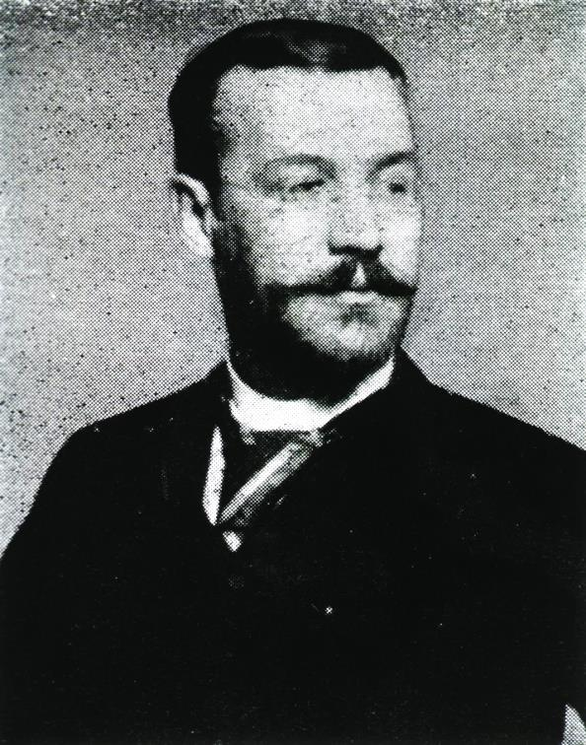
Cyanotic CHD
Eisenmenger physiology
↓ PBF
PAH
1897
Irreversible pulmonary
vascular disease
in a 32 year old man with
non-restrictive VSD
Dr. Victor Eisenmenger
1864 - 1932

Slide 39
Cyanotic CHD
Eisenmenger physiology
↓ PBF
PAH
Cyanosis
•
Eisenmenger physiology is not confined to shunt
in atrial, ventricular and pulmonary artery level alone.
•
Pulmonary vascular obstructive disease
can occur very early in Transposition physiology,
ie., Cyanosis with ↑ PBF
Cyanosis in Eisenmenger physiology
is NOT always late in life
Pearl

Slide 40
Cyanotic CHD
Eisenmenger physiology
↓ PBF
PAH
• ASD / VSD / PDA /APW+ PAH - Rt. to Lt. shunt
• DORV + PAH
• DTGA + PAH
• TAPVC + PAH
• HLHS (Aortic atresia, Mitral atresia)

Slide 41
Eisenmenger physiology
Cyanotic CHD
↓ PBF
PAH
Clinical Features
Common to all pts.
with initial  PBF
• h/o Frequent respiratory infections in infancy
• Cyanosis : From birth or appears late
• JVP : Prominant 'a'
• No Cardiomegaly (except in Rt. to Lt. Atrial shunt)
• Parasternal impulse due to RVH
• Constant EC of PAH
• S2 : Palpable, P2 loud
• Disappearance of shunt & flow murmurs in Lt. to Rt. shunts
• Insignificant or absent Pul. systolic murmur
• PR &/or TR murmur maybe present

Slide 42
Cyanotic CHD
Eisenmenger physiology
↓ PBF
PAH
Differention of lesions
 | ASD | VSD | PDA
1. Cyanosis | Uniform | Uniform | Differential
2. Cardiomegaly | Present | Absent | Absent
3. Parasternal impulse | Heaving | Mild | Mild
4. S2 | Wide Fixed split | Single | Normally split
5. TR | Common | Rare | Rare
6. CXR : Asc. Aorta | Normal | Normal | Large

Slide 43
Cyanotic CHD
Eisenmenger physiology
↓ PBF
PAH
Chest Xray :
• No cardiac enlargement
(Cardiac enlargement in ASD)
• Large hilar PA
•‘Cut-off’ beyond medial 1/3
of pulmonary vasculature

Slide 44
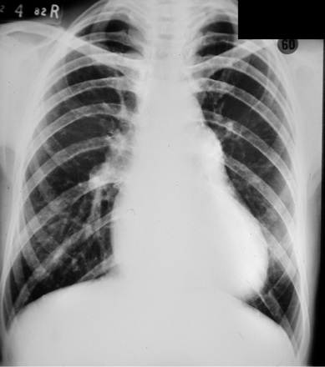
Cyanotic CHD
CXR
↓ PBF
PAH
EISENMENGER
SYNDROME
- No cardiomegaly
- Large hilar PA
Dilated PA segment
-  PBF and PAH
with Pulmonary vessels
‘Cut-off ‘ beyond
medial 1/3
(Peripheral Pruning)

Slide 45
Cyanotic CHD
Eisenmenger physiology
↓ PBF
PAH
ECG
QRS AXIS | CHAMBER HYPERTROPHY | CONDITION
RAD | RVH | VSD / PDA / ASD / APW / TGA / DORV / SV / TAPVC
RAD | LVH | SV / Hypoplastic RV
LAD | LVH | TA / SV
LAD | RVH | SV / AVCD

Slide 46
Cyanotic
Congenital Heart Disease
↓ PBF
CE / HF

Slide 47
Cyanotic Cong. HD
↓ PBF
Cardiomegaly (CE) / HF
• Ebstein’s Anomaly
• PS + TR

Slide 48
Cyanotic CHD
EBSTEINS ANOMALY
↓ PBF
CE/HF
Clinical features
• Quiet precordium
• LV apical impulse
• S1 : Normal/Split
• S2 : Wide split
Variable P2 - Normal or 
• S3, S4 present
• Mid-systolic click
• Scratchy ESM of TR at LLSB
• Scratchy MDM at LLSB
Multiple sounds

Slide 49
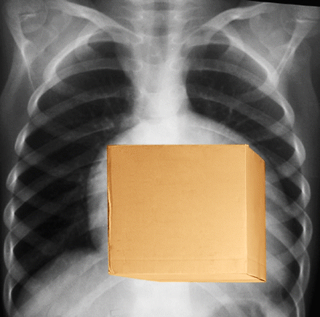
Cyanotic CHD
CXR
↓ PBF
CE/HF
EBSTEINS ANOMALY
- PBF
- MPA not prominent
- Marked Cardiomegaly
(Box-type heart)
- LV type apex

Slide 50
Cyanotic CHD
CXR
↓ PBF
CE/HF
PS + TR
( Rt.to Lt Shunt thro ASD)
- PBF
- MPA prominent
- Marked Cardiomegaly
(due to TR)
- RAE & RV apex

Slide 51
Cyanotic CHD
ECG
↓ PBF
CE/HF
• Ebsteins Anomaly
- RAE
- Polyphasic QRS
- No RVH
- RBBB
- WPW
• PS + TR (with intact IVS)
- Severe RVH
- Late transition
• LTGA
- Ventricular inversion
- CHB
• ECD
- LAD

Slide 52
2
↑ PBF

Slide 53
Cyanotic Cong. HD
↑ PBF
Transposition
physiology

Slide 54
Cyanotic CHD
Cyanotic Cong.HD
↑ PBF
CE/HF
↑ PBF
Transposition physiology
• DTGA/VSD
• DORV/VSD
• Truncus Arteriosus
• Tricuspid Atresia/Large VSD
• Single Ventricle
• TAPVC
/No PS
/No PS
/No PS
/No PS

Slide 55
Cyanotic CHD
Transposition physiology
↑ PBF
CE/HF
Symptoms
1. Symptomatic in neonatal period
2. Cyanosis : Mild to Severe
3. CCF : Tachypnea, Weight loss,
Failure to thrive and gain weight

Slide 56
Cyanotic CHD
Transposition physiology
↑ PBF
CE/HF
Clinical Examination
1. Hyperdynamic precordium
2. Cardiomegaly : Appears within 2 weeks of life
3. S2 : Variable
TGA - Single (Normal split rarely heard as PA is posterior)
S3 gallop
4. Gr. I-II insignificant ESM at base.
Flow murmur - Mid diastolic at apex, tricuspid area
Diastolic murmur - 2LICS in Truncus
No continuous murmur
5. CXR : Cardiomegaly with Pulmonary Plethora

Slide 57
Cyanotic CHD
Transposition physiology
↑ PBF
CE/HF
Chest X-ray
1. Cardiomegaly
2. Plethoric lung fields - lateral 2/3
3. Absent MPA segment
➢ Prominent MPA : TAPVC
4. Right Arch - Truncus

Slide 58
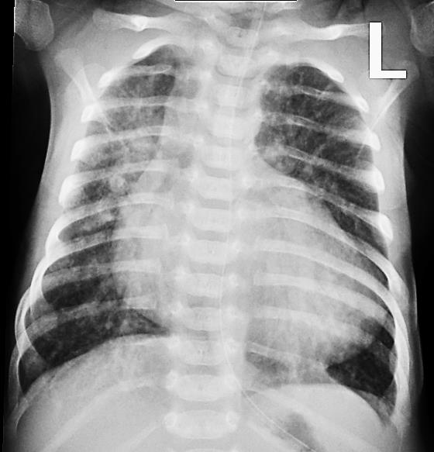
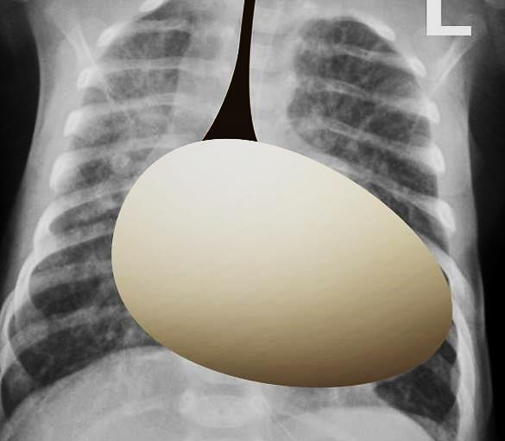
Cyanotic CHD
Compare
Cyanotic CHD
↓ PBF
PS
VSD
↑ PBF
CE/HF
Fallot’s physiology
Transposition physiology
TOF
DTGA + VSD
↓ PBF
↑ PBF

Slide 59
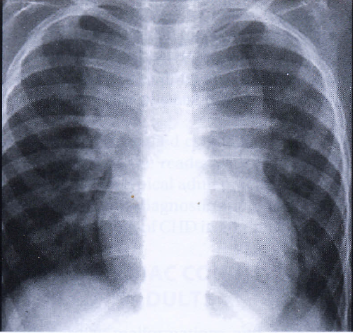
Innominate vein
Cyanotic CHD
CXR
↑ PBF
CE/HF
SUPRACARDIAC
TAPVC
Dilated SVC
Vertical vein
(draining the
confluence of PV)
Cardiac
shadow
Cardiomegaly
Prominent MPA
Pulmonary Plethora
in a cyanotic child indicates
Cyanotic CHD with  PBF
# Figure of 8 / Snowman appearance

Slide 60
Cyanotic CHD
Transposition physiology
↑ PBF
CE/HF
ECG
Not very contributory - BVH often
QRS AXIS | CHAMBER HYPERTROPHY | CONDITION
RAD | RVH | TGA / TAPVC / DORV / PTA / SV
RAD | LVH | Hypoplastic RV / SV
LAD | LVH | TA / SV / Hypoplastic RV / AVCD
LAD | RVH | SV / DORV / AVCD
DTGA (Intact IVS)
TAPVC
RAD /RVH
P Pulmonale (TAPVC)
DTGA + VSD
RAD / BVH / LVH

Slide 61
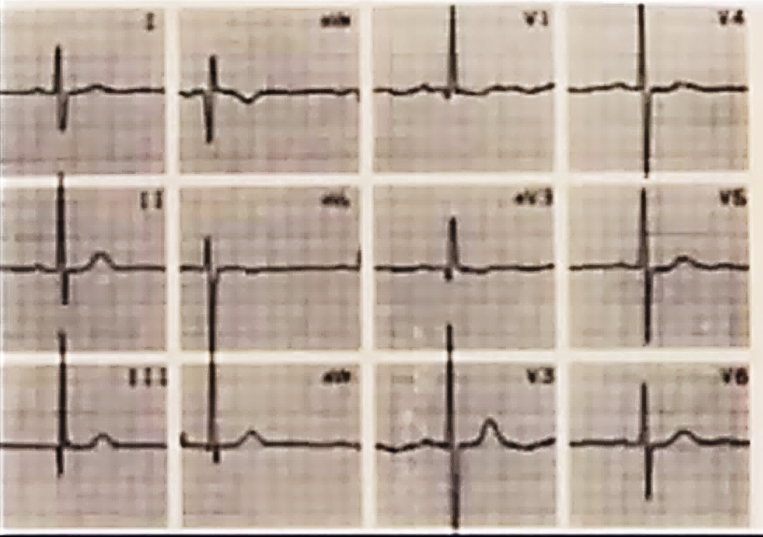
Cyanotic CHD
Transposition physiology
↑ PBF
CE/HF
ECG
RAD / BVH :
DTGA + VSD

Slide 62
3
N-PBF

Slide 63
Cyanotic Cong.HD
Normal PBF
1. Pulmonary AV Fistula
2. LSVC to LA

Slide 64
Cyanotic CHD
Normal PBF
Clinical Features :
1. Quiet precordium
2. No Cardiomegaly
3. NORMALLY SPLIT S2
4. No murmur in the precordium
Peripheral Continuous murmur in Pul. AVF
Chest Xray :
May help in Pul. AVF
ECG :
Normal

Slide 65
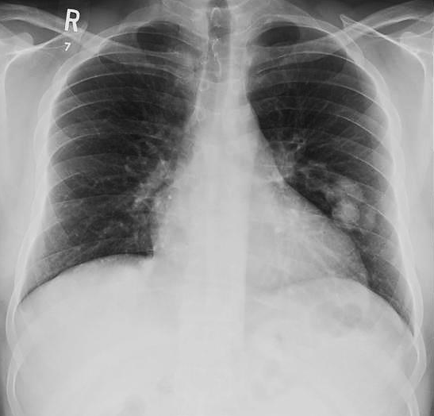
Cyanotic CHD
CXR
Normal PBF
PULMONARY
AV FISTULA

Slide 66
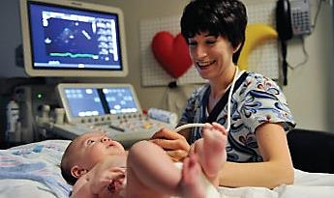
ECHO
ECHO

Slide 67
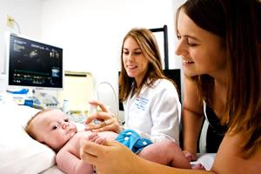
ECHO
Role of Echocardiography
1. Mainstay in final confirmation of diagnosis
2. Exact anatomical diagnosis
3. Physiological classification - PS / No PS
4. Hemodynamic information - PA pressure etc.
5. Assessment of Ventricular function
6. Decides the type of repair needed
• Pediatric echocardiography must be performed by skilled
personnel, since errors are possible
• Hence provisional diagnosis must be made based on clinical
examination, CXR and ECG before echocardiography

Slide 69
• Bedside precise anatomic diagnosis is not always possible
• Have a systematic approach with history, physical
examination and categorize into ‘Physiological Groups’
• Problems in clinical diagnosis:
- Neonates with fast heart rates and changing physiology
- Polycythemia masks the murmurs
• Echocardiography should be performed as early as
possible as it has exposed loop holes in clinical diagnosis

Slide 70
• Assess whether the pt. has a life-threatening condition
eg. a deeply blue child, Severe respiratory distress / shock.
• Infants with HF : Cyanotic CHD with PBF is more likely
• Neonates with Shock : Often Ductus dependent CHD.
• Older infants / children with cyanosis :TOF or its variants.
• Absence of HF : Normal-sized heart, Pul. oligemia on CXR

Slide 71
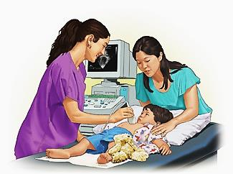
Cyanotic
Congenital Heart Disease
- Diagnostic Approach -
THE BEST

Slide 72
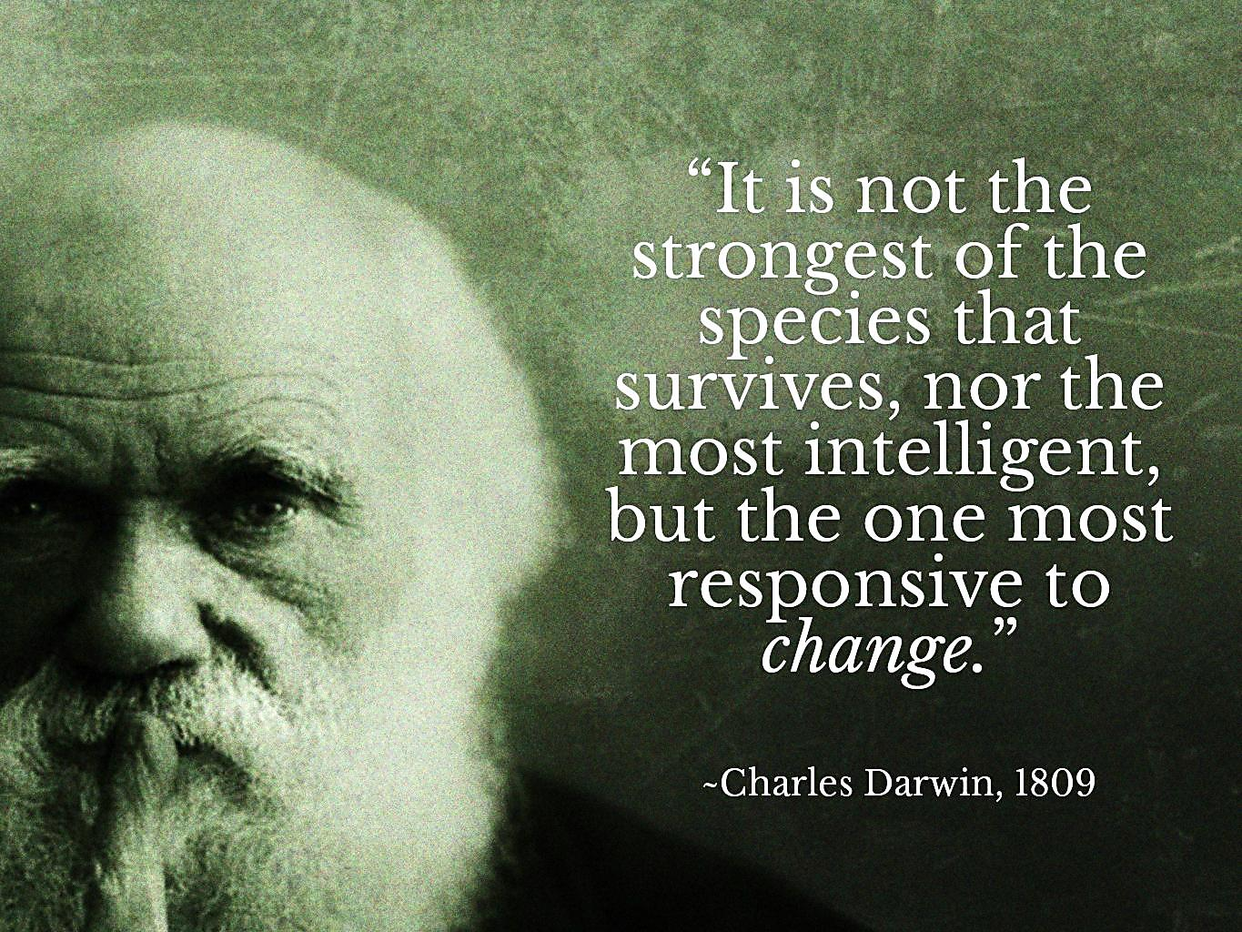

Slide 73
Thanks

